Slide 1

The Core of Logic
Comprehensive JavaScript Functions Masterclass

Slide 2
The Foundation
Why functions are the building blocks of applications

Slide 3


What are Functions?
Logical Encapsulation
Unmatched Reusability
Functions allow you to wrap complex logic into a single named block. This "black box" approach simplifies software architecture by hiding execution details from the rest of the application ecosystem.
The "DRY" (Don't Repeat Yourself) structural approach is fully powered by functions. Instead of redundant code, you call the logic with different arguments, keeping your codebase clean.

Slide 4






Three Primary Declaration Types
Declarations
Expressions
Arrow Functions
The classic syntax. Hoisted fully by the JS engine, allowing execution even before definition in code flow.
Functions stored inside variables. Not hoisted; enforces strict sequence and scoping.
Introduced in ES6. Features shorter syntax and distinct lexical contextual binding of 'this'.

Slide 5
The Modern Shift
Evolution of syntax and execution patterns

Slide 6
Arrow Functions
Arrow functions represent more than just syntax shortcuts. They actively resolve context binding issues within nested callbacks and dynamic scopes.
By enforcing a lexical scope for the this value, they ensure references maintain logical integrity, removing the necessity of calling .bind() or saving scope context variables.

Slide 7
Handling Dynamic Data
Parameters vs Arguments: Parameters act as structural placeholders inside definition signatures; Arguments are the active variables supplied.
Default Parameters: Assign elegant fallback values inline inside parameters directly (e.g., function greet(name = 'Guest')).
The Rest Parameter: Captures indefinite trailing parameters using ...args, consolidating multiple inputs into an indexed array.
The Return Statement: Halts execution path immediately and passes computed data back. Unspecified returns result in undefined.

Slide 8
Execution Context
The LIFO Call Stack
10k+
When multiple active functions invoke nested dependencies, JS tracks execution steps using a stack. Infinite executions call recursive bounds until bounds exceed maximum threshold.
Understanding call stacks is vital for tracking memory usage, isolating recursive blocks, and preventing system freezing.
Maximum Stack Depth Limit

Slide 9
Advanced Patterns
Higher-order structures and functional composition

Slide 10

Functional Programming Trends
The continuous shift toward functional paradigms has accelerated exponentially with arrow constructs and declarative architectures.

Slide 11



Higher-Order Functions
Callbacks
Returned Functions
Closures
Functions nested inside parameters, called dynamically as logic finishes.
Custom factories creating specialized dynamic execution blocks.
When functions retain physical state definitions after leaving environments.

Slide 12
The Philosophy of Code
"
"Programming is not about typing; it's about thinking. Functions are the crystallized thoughts of the engineer."
— Senior Software Architect

Slide 13
Evolution of Logic
ES1: The Start
ES5: Scoping
ES6: Arrows
Modern: Async
Standard Declarations establish foundation.
Strict mode and assigned block expressions.
Concise functional definitions and defaults.
Non-blocking loops and generator states.

Slide 14
Modern Execution
Advanced lifecycle control and design pattern integrations

Slide 15
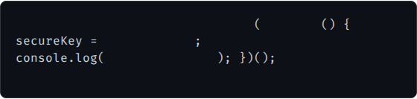
Self-Executing Functions (IIFE)
An Immediately Invoked Function Expression runs instantly upon runtime evaluation.
// Standard self-contained IIFE
function
const
"X98A1_PROD"
// Error: secureKey is not defined here
"Bootstrapped!"
Encapsulates internal scope safely.
Prevents global naming namespace pollution.
Foundational design pattern before native modules.

Slide 16
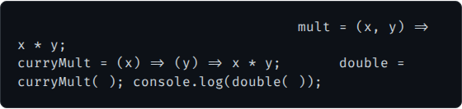
Function Currying Patterns
// Standard multi-parameter
const
Currying transforms a multi-argument function signature into nested single-argument function returns.
// Curried sequential nesting
const
const
2
5
// Returns 10
It facilitates partial application, creating highly modular, contextual configurations before invoking computations.

Slide 17

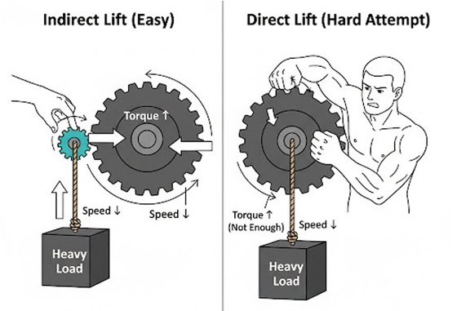

Generator Functions
Generators can halt mid-execution lifecycle and later resume state computation, breaking the standard "run-to-completion" paradigm.
Utilizes unique yield sequences paired with the asterisk function* signature.
function*
yield
'Step 1'
yield
'Step 2'

Slide 18
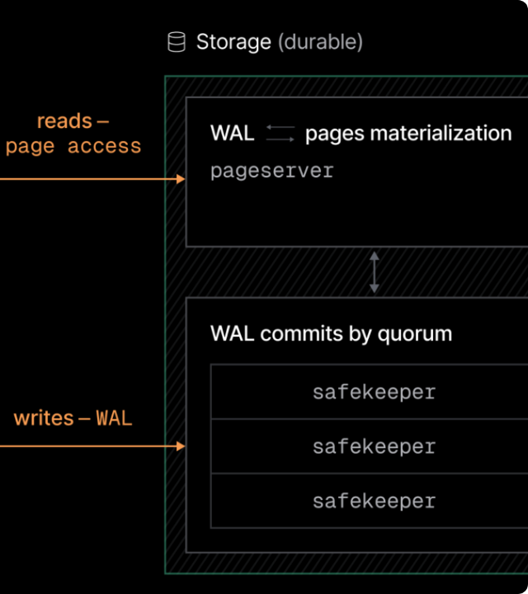
Asynchronous Operations
Because JavaScript operates on a single-threaded architecture, non-blocking flow control is essential to prevent user interface latency.
The modern combination of async declarations and await operations handles background asynchronous tasks seamlessly, producing logical flow structures reminiscent of synchronous execution paths.

Slide 19






Clean Code Best Practices
Single Focus
Keep It Pure
Semantic Names
Functions must handle only one specific logical task. If operations merge tasks, isolate dependencies into clean sub-methods.
Aim for side-effect-free code. Supplying identical inputs should consistently return duplicate outputs without mutating outer scopes.
Name functions descriptive of their primary actions. Use action verbs (e.g., fetchData, verifyEmail, computeSum).

